Slide 1



Space for Everyone Quiz True or False…
Notes:
Notes for teachers –
Quiz statements and further information for discussion can be found in the resource ‘Space Jobs Quiz’

Slide 2
Women and men can go to space
Notes:
Notes for teachers –
Ask the class to vote on each statement before you go to the next slide.
The next slide reveals the answer.
Quiz statements and discussion prompts can be found in the resource ‘Space for Everyone Quiz’

Slide 3
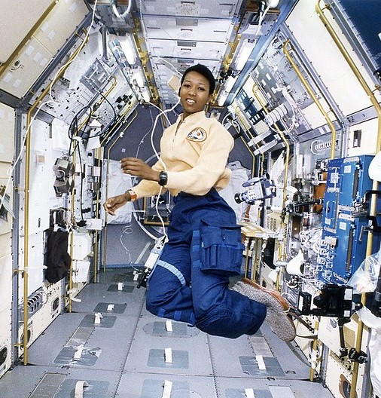
Mae Jemison is a former NASA Astronaut
TRUE!
501 men and 65 women have been to space.
Helen Sharman was the UK’s first astronaut!
Notes:
https://www.schoolsobservatory.org/careers/interested/spaceflight/mae-Jemison
Image credit: NASA
Numbers correct January 2021

Slide 4
All scientists are men
Notes:
Notes for teachers –
Ask the class to vote on each statement before you go to the next slide.
The next slide reveals the answer.
Quiz statements and discussion prompts can be found in the resource ‘Space for Everyone Quiz’

Slide 5
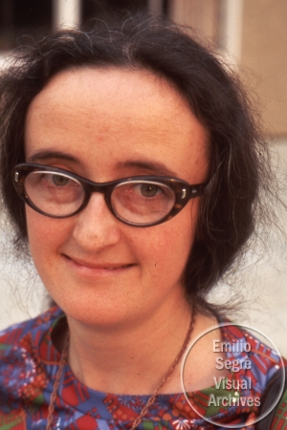
Beatrice Tinsley was an Astronomer
FALSE
Astronomers are scientists who study objects in space.
Notes:
https://www.schoolsobservatory.org/careers/interested/stargazing/beatrice-tinsley
Image Credit: AIP Emilio Segrè Visual Archives, John Irwin Slide Collection Low res image used with permission

Slide 6
The best science shows are presented by men
Notes:
Notes for teachers –
Ask the class to vote on each statement before you go to the next slide.
The next slide reveals the answer.
Quiz statements and discussion prompts can be found in the resource ‘Space for Everyone Quiz’

Slide 7
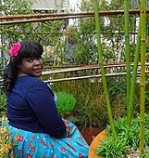
FALSE
Lots of men and women present great science shows on TV and YouTube.
Maggie Aderin-Pocock is a TV presenter and a space scientist
Notes:
https://www.schoolsobservatory.org/careers/interested/explaining/maggie-aderin-Pocock
Credit: Science and Technology Facilities Council

Slide 8
Most of the first computer programmers were women
Notes:
Notes for teachers –
Ask the class to vote on each statement before you go to the next slide.
The next slide reveals the answer.
Quiz statements and discussion prompts can be found in the resource ‘Space for Everyone Quiz’
’

Slide 9
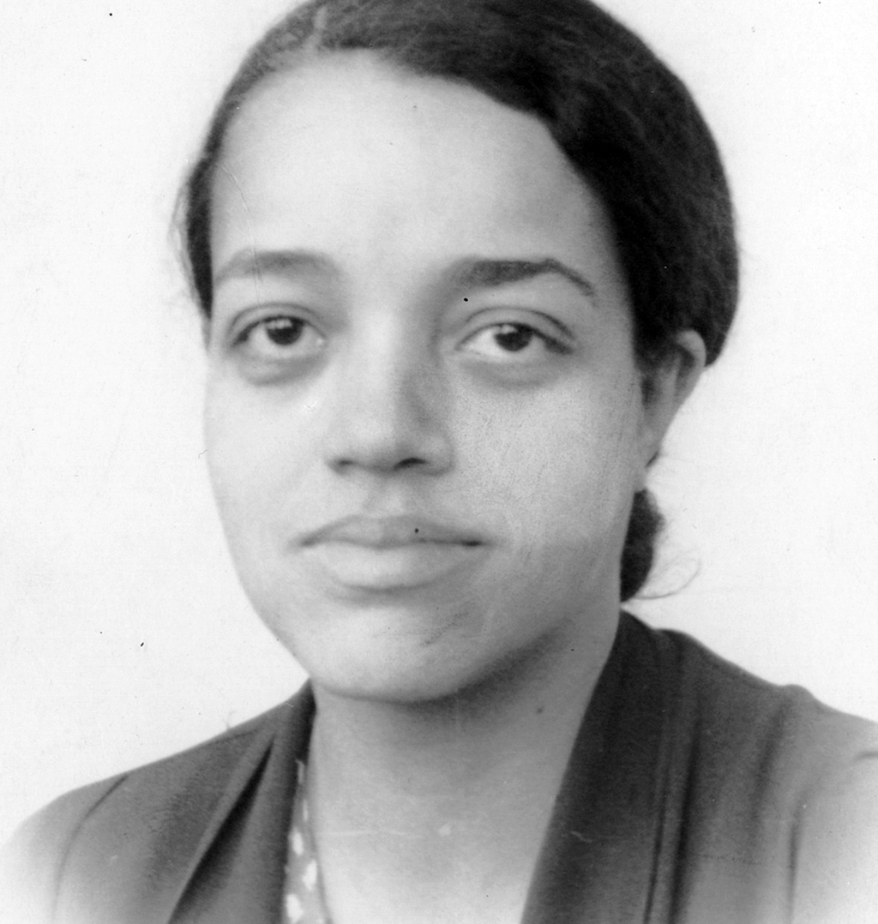
TRUE!
Many black, women wrote computer code for NASA in the 1950s.
Dorothy Vaughan was a NASA computer programmer
Notes:
https://www.schoolsobservatory.org/careers/interested/computers/dorothy-Vaughan
Credit: Unknown author

Slide 10
Women can be engineers
Notes:
Notes for teachers –
Ask the class to vote on each statement before you go to the next slide.
The next slide reveals the answer.
Quiz statements and discussion prompts can be found in the resource ‘Space for Everyone Quiz’

Slide 11
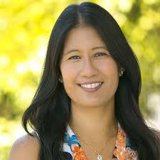
TRUE!
Engineers like Mimi, design robots that are sent to explore other planets for us!
Mimi Aung is a Space Engineer
Notes:
https://www.schoolsobservatory.org/careers/interested/making/mimi-aung
Credit: NASA/JPL

Slide 12
Men don’t care about plants and animals
Notes:
Notes for teachers –
Ask the class to vote on each statement before you go to the next slide.
The next slide reveals the answer.
Quiz statements and discussion prompts can be found in the resource ‘Space for Everyone Quiz’
’

Slide 13
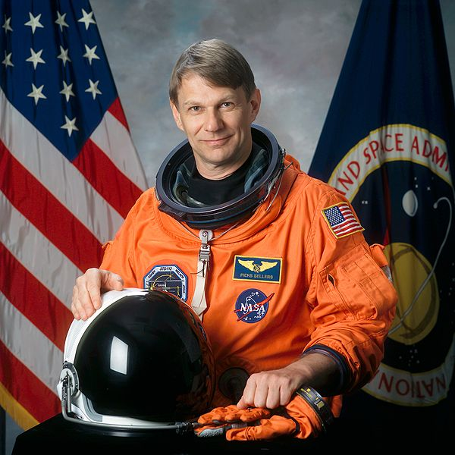
Piers Sellers, NASA astronaut and climate change scientist
FALSE
Men like Piers want everyone to work together to help look after our beautiful planet, Earth.
Notes:
https://www.schoolsobservatory.org/careers/interested/nature/piers-sellers
Credit: NASA

Slide 14
Women are better at writing than men
Notes:
Notes for teachers –
Ask the class to vote on each statement before you go to the next slide.
The next slide reveals the answer.
Quiz statements and discussion prompts can be found in the resource ‘Space for Everyone Quiz’

Slide 15
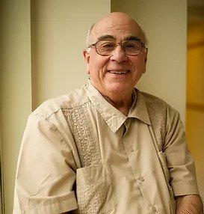
Anthony Aveni is an astronomer and author of many books, including some children’s books
FALSE
Authors say that reading lots of book can help you to become a better writer.
Notes:
https://www.schoolsobservatory.org/careers/interested/history/anthony-aveni
Credit: All rights reserved. Used by permission.

Slide 16
Men are braver than women
Notes:
Notes for teachers –
Ask the class to vote on each statement before you go to the next slide.
The next slide reveals the answer.
Quiz statements and discussion prompts can be found in the resource ‘Space for Everyone Quiz’

Slide 17
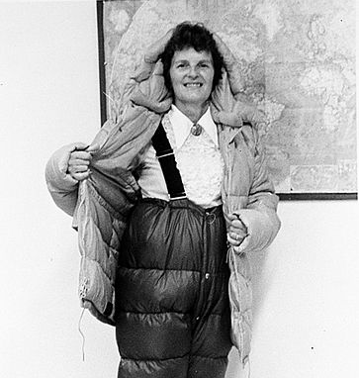
Ursula Marvin was an Explorer. She travelled to Antarctica to study meteorites found there.
FALSE
Men and women have braved flying to space, sailing around the world, and trekking to the South Pole.
Notes:
https://www.schoolsobservatory.org/careers/interested/exploring/ursula-marvin
Credit: Charles Hanson

Slide 18
Women can be maths experts
Notes:
Notes for teachers –
Ask the class to vote on each statement before you go to the next slide.
The next slide reveals the answer.
Quiz statements and discussion prompts can be found in the resource ‘Space for Everyone Quiz’
’

Slide 19
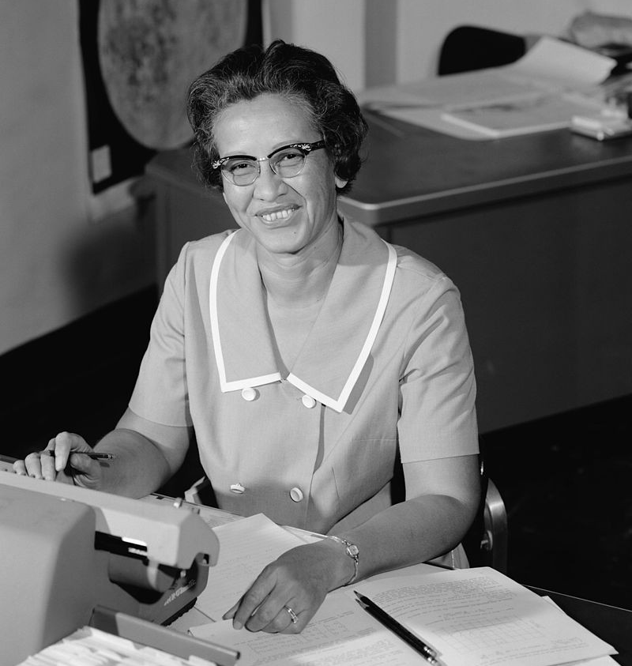
Katherine Johnson was a NASA mathematician
TRUE!
Most jobs need you to use maths in some way. Katherine used maths to help send astronauts to the Moon!
Notes:
https://www.schoolsobservatory.org/careers/interested/numbers/katherine-johnson
Credit: NASA

Slide 20
Men are better leaders than women
Notes:
Notes for teachers –
Ask the class to vote on each statement before you go to the next slide.
The next slide reveals the answer.
Quiz statements and discussion prompts can be found in the resource ‘Space for Everyone Quiz’

Slide 21
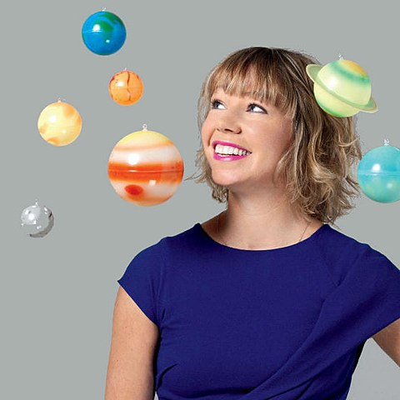
Alice Bunn is a Leader at the UK Space Agency
FALSE
Women have led countries including the UK, New Zealand, Germany, Bangldesh, and Barbados.
Notes:
https://www.schoolsobservatory.org/careers/interested/influencing/alice-bunn
Credit: UK Gov

